Slide 1
Library management system
Chethana Jayarathne

Slide 2
A Library Management System is a software built to handle the primary housekeeping functions of a library. Libraries rely on library management systems to manage asset collections as well as relationships with their members. Library management systems help libraries keep track of the books and their checkouts, as well as members’ subscriptions and profiles.

Slide 3
System Requirements
Any library member should be able to search books by their title, author, subject category as well by the publication date.
Each book will have a unique identification number and other details
There could be more than one copy of a book, and library members should be able to check-out and reserve any copy.
The admin should be able to retrieve information like who took a particular book or what are the books checked-out by a specific library member.
There should be a maximum limit (5) on how many books a member can check-out.
There should be a maximum limit (10) on how many days a member can keep a book.
The system should be able to collect fines for books returned after the due date.
Members should be able to reserve books that are not currently available.

Slide 4
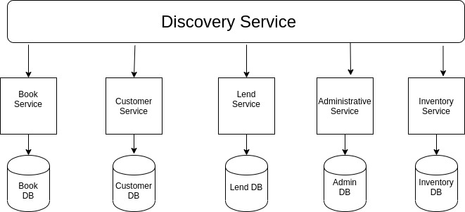
Microservice Architecture Diagram

